Slide 1
GERIATRIC ASSESSMENT
LECTURER. Dr JOELSOLOZANO ROMERO

Slide 2
GERIATRIC ASSESSSMENT
The geriatric assessment is a multidimensional, multidisciplinary diagnostic instrument designed to collect data on the medical, psychosocial and functional capabilities and limitations of elderly patients.
Various geriatric practitioners use the information generated to develop treatment and long-term follow-up plans, arrange for primary care and rehabilitative services, organize and facilitate the intricate process of case management, determine long-term care requirements and optimal placement, and make the best use of health care resources

Slide 3
Approximately one-half of the ambulatory primary care for adults older than 65 years is provided by family physicians and approximately 22 Percent of visits to family physicians are from older adults. It is estimated that older adults will comprise at least 30 percent of the patients in typical family medicine outpatient practices , 60 percent in hospital pratices, and 95 percent in nursing home and home care practices.

Slide 4
CHARACTERISTICS
The geriatric assessment differs from a standard medical evaluation in three general ways:
it focuses on elderly individuals with complex problems
(2) it emphasizes functional status and quality of life
(3) it frequently takes advantage of an interdisciplinary team of providers.

Slide 5
Performing a comprehensive assessment is an ambitious undertaking.
• Current symptoms and illnesses and their functional impact.
• Current medications, their indications and effects.
• Relevant past illnesses.
• Recent and impending life changes.
• Objective measure of overall personal and social functionality.
• Current and future living environment and its appropriateness to function and prognosis.
• Family situation and availability.
• Current caregiver network including its deficiencies and potential.
• Objective measure of cognitive status.
• Objective assessment of mobility and balance.
• Rehabilitative status and prognosis if ill or disabled.
• Current emotional health and substance abuse.
• Nutritional status and needs.
• Disease risk factors, screening status, and health promotion activities.
• Services required and received.

Slide 6
COMMUNICATION STRATEGIES
ESTABLISH A FRIENDLY RELATIONSHIP
Introduce yourself
Address the patient by last name
Face the patient directly
Sit at eye level
• Speak slowly in a deep tone
• Ask open-ended questions: “What would you like me to do for you?”

Slide 7
Inquire about hearing deficits, raise voice volume accordingly
If necessary, write questions in large print
Allow ample time for patient to answer

Slide 8
PRINCIPLES OF GERIATRIC ASSESSMENT
Goal. Promote wellness, independence
Focus. Function performance (gait, balance, transfers)
Scope. Physical, cognitive, psychologic, social domains
Approach. Multidisciplinary
Efficiency. Ability to perform rapid screens to identify target areas
Success. Maintaining or improving quality of life

Slide 9
Comprehensive Geriatric Assessment
An interdisciplinary approach to the evaluation of older persons’ physical and psychosocial impairments and their functional disabilities
3-step process:
1. Targeting appropriate patients
2. Assessing patients and developing recommendations
3. Implementing recommendations
Notes:
Comprehensive Geriatric Assessments--are made in order to develop a
comprehensive plan for prevention,treatment and rehabilitation
Interdisciplinary team---focuses on physical,mental and social issues.
These factors are intertwined as etiology of functional problems in elderly
persons.
Impairment is used here to describe an abormality of psychological and/or
anatomical structure or function. Disability is used to describe any restriction
or lack of ability to perform certain activities as a result of an impairment.
General functional assessment takes into account the capabilities of the patient,
the social environment and resources.
We must remember that recognition of these impairments does not equal
rapid implementation of preventive or treatment measures.

Slide 10
Purpose
Highest priority:
  Prevention of decline in the independent performance of ADLs
  Drives the diagnostic process and clinical decision making
Screen for preventable diseases
Screen for functional impairments that may result in physical disability and amenable to intervention

Slide 11
Rationale
Early detection of risk factors for functional decline when linked to specific interventions may help reduce the incidence of functional disability and dependency for older patients

Slide 12
The Comprehensive Assessment of an Older Person
Domains of Assessment
Sources of collateral information
Use of professional interview style
Timeliness and consistency
Interdisciplinary
Use of Validated assessment tools
Questions

Slide 13
Patient Focused Assessment:
Privacy and confidentiality;
Information
Consent
A carer/advocate
Participate in decision-making
A copy of the assessment/outcomes
Complaint and appeal information.
Explain reason for assessment

Slide 14
The Comprehensive Assessment of an Older Person
Domains of Assessment
Physical
Mental
Social
Environmental
Functional - physical
- mental
- social activities of daily life

Slide 15
The Comprehensive Assessment of an Older Person
Benefits of Comprehensive Geriatric Assessment
Depends upon setting but, overall:
Improved diagnostic attainment
Increased use of home health services
Reduced medical care costs
Reduced length of hospital stay
Reduced or delayed admission to institutional care
Improved functional status : fewer medications
: improved cognition
Reduced readmission rates
Increased survival (less often)

Slide 16
The Comprehensive Assessment of an Older Person
Aims and Framework of Assessment
Improve, maintain or reduce rate of functional decline.
Aim to improve or maintain independence and autonomy.
Multidisciplinary assessment to harness specialty skills in key areas.
Translation of assessment to action plans to add value to care, is critical.

Slide 17
Sources of Collateral Information:
Introduction to patient
Consent for interview, focus on the patient initially
Not performance theatre, recognise privacy
Extended to involve most important others as appropriate
Avoid pre-interview sessions where possible

Slide 18
Timeliness and Consistency:
The hallmark of the Geriatric syndrome is where an older person is predisposed to an adverse event that only requires a precipitant to occur e.g.
Falls and injury
New incontinence
Delirium
Reduced mobility
Iatrogenic events

Slide 19
The Comprehensive Assessment of an Older Person
What are the clues for increasing urgency?
Age – extreme
Lives alone
Source of referral
Urgency annotation
New features of illness
Polypharmacy
Recent functional decline
Worsening confusion (i.e. delirium)

Slide 20
The Comprehensive Assessment of an Older Person
Medically-orientated Assessment
The Geriatric Assessment is performed in addition to standard medical history and physical examination.
The assessment seeks to uncover common conditions of frailty that affect functional status, e.g.
- Impaired vision
- Impaired hearing
- Reduced mobility and falls
- Geriatric syndromes - Cognition
- Depression
- Malnutrition
- Urinary incontinence
- Falls
- Iatrogenic illness

Slide 21
The Comprehensive Assessment of an Older Person
INTERDISCIPLINARY
The comprehensive assessment can be done by a generic elderly health care worker, a General Practitioner, medical specialist or through a multi-disciplinary approach.
It can be extended over time and place.
The tools of assessment are the structured interview utilising screening instruments for:
Cognitive
Affective
Functional
Social (context and consequences)
Economic status
Assessment especially useful for :
        People in transition
        Recent onset of physical or cognitive impairment
Fragmented (medical) care
Care-giver strain.

Slide 22
Comprehensive Geriatric Assessment
Who needs a geriatric assessment?
Notes:
Appropriate placement---------------
1.gerirehab
2.community +/- homecare
3.institutional long term care
4.assisted living+/- day programs
Disagreement with the too sick to benefit category specifically NH-- pts
at NH also receive assessments especially in gerirehab.

Slide 23
Comprehensive Geriatric Assessment
Too Sick to Benefit
  Critically ill or medically unstable
  Terminally ill
  Disorders with no effective treatment
Appropriate and Will Benefit
  Multiple interacting biopsychological problems that are amenable to treatment
  Disorders that require rehabilitation therapy

Slide 24
Comprehensive Geriatric Assessment
Too Well to Benefit
  One or a few medical conditions
  Needing prevention measures only

Slide 25
Who Needs Assessments?
For patients with living situation in transition
Recent development of physical or cognitive impairments
Patients with fragmented specialty medical care
Evaluating patient competency/capacity
Dealing with medico-legal issues
NIH Consensus Devt Conf JAGS, 1990

Slide 26
Physical Health
The geriatric assessment incorporates all facets of a conventional medical history, including main problem, current illness, past and current medical problems, family and social history, demographic data, and a review of systems. The approach to the history and physical examination, however, should be specific to older persons. In particular, topics such as nutrition, vision, hearing, fecal and urinary continence, balance and fall prevention, osteoporosis, and polypharmacy shoul be included in the evaluation

Slide 27
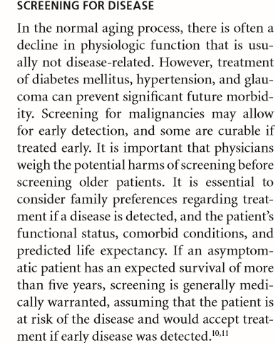

Slide 28
Functional Assessment
Functioning can be assessed through informal means, such as observing the individual, and asking the individual, family, and staff questions, or through formal testing. Historically, functioning as been formally assessed through ADL and IADL rating scales.

Slide 29
Comprehensive Geriatric Assessment
KATZ INDEX OF ACTIVITIES OF DAILY LIVING
Bathing
Dressing
Toileting
Transfer
Continence
Feeding
Independent
Assistance
Dependent
Katz S et al. Studies of Illness in the Aged: The Index of ADL; 1963.
Notes:
One measure of independence is the capacity to perform functional tasks
Necessary for daily living.
Katz’s ADL’s----developed in the 1960’s. Measuring six functions,each noted
either as independent or dependent
Initially used by a professional (nurse in an inpt setting) based on observations
over a week
Since then, many modifications
Mnemonic---- “DEATH” --- a way to help you remember the activities
Evaluated--- D= dressing, E=eating, A=ambulating, T= toileting, H=hygiene

Slide 30
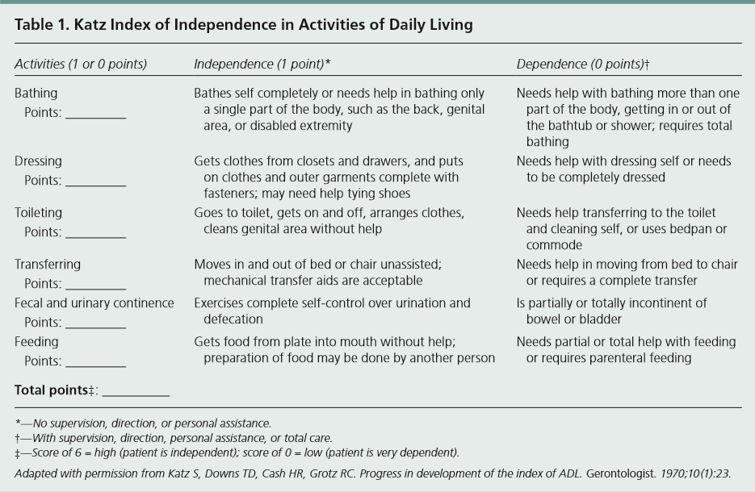

Slide 31
Comprehensive Geriatric Assessment
INSTRUMENTAL ACTIVITIES OF DAILY LIVING
Telephone
Traveling
Shopping
Preparing meals
Housework
Medication
Money
Independent
Assistance
Dependent
The Oars Methodology: Multidimensional Functional Assessment Questionnaire; 1978.
Notes:
Labor saving equipment may change laundry from an impossiblity to a
manageable task
Some men who can not prepare meals may simply not know how to cook
Instrumental (community interactions)--- mnemonic “SHAFT”
S=shopping, 2.H=housework, 3. A=Accounting, 4. F=food preparation and
5. T=transportation

Slide 32
Financial capacity is a complex, multidimensional construct representing a broad range of conceptual, pragmatic, and judgmental skills
Specific Abilities and Tasks The first functional element is specific financial abilities or tasks, each of which is relevant to a particular domain of financial activity. In the model, many general domains can be further broken down into component tasks or abilities that emphasize understanding and pragmatic application of skills relevant to a specific domain. For instance, the domain of financial conceptual knowledge involves understanding concepts, such as loans and savings, and also using this information to select advantageous interest rates. Similarly, bill payment involves not only understanding what a bill is and why it should be paid, but accurately reviewing a bill and preparing it for mailing.

Slide 33
Assessing Cognition
During the Clinical Interview Although cognitive testing will provide the standardized data to determine the presence or absence of impaired cognition, interview data can also provide a wealth of information regarding the nature and extent of the impairment. Many clinicians will begin with a brief mental status screening using an interview format or specific screening test to obtain an estimate of level of functioning

Slide 34
Cognitive screening tests are useful for giving a general level of overall cognitive impairment. They may be used as an overall screening to determine whether additional testing is needed. They may also be used for individuals with more severe levels of impairment who cannot complete other tests

Slide 35
MMSE Mini Mental State Examination
30-point screening instrument that assesses orientation, immediate registration of three words, attention and calculation, short-term recall of three words, language, and visual construction

Slide 36
Comprehensive Geriatric Assessment
THE FOLSTEIN MINI-MENTAL STATE EXAMINATION
Orientation: What is the year/season/date/day/month?
Where are we state/county/town/hospital/floor?
Registration: Name 3 objects: 1 second to say each.Then ask the patient all 3 after you have said them.
Attention/ Calculation: Begin with 100 and count backward by 7. Alternatively, spell “WORLD” backwards.
Recall: Ask for all 3 objects repeated above.
Notes:
It is an abbreviated structured mental status examination that takes approximat-
Ely 5 – 10 minutes to administer. Points are awarded for correct responses to
Questions with maximum of 30,
A score of less than 20--- increased chance of impairment, score of 24 is the
Cutoff mark. Above 26 it is unlikely to have an impairment, score between 21
25– is the intermediate level and may be the gray zone.
The patient’s educational level affects the results and should be taken into
Account.
This tool has been validated in many trials.

Slide 37
Comprehensive Geriatric Assessment
THE FOLSTEIN MINI-MENTAL STATE EXAMINATION
Language: Show a pencil & a watch and ask the patient to name them.
Repeat: “No ifs, and or buts.”
A 3 stage command: “Take the paper in your right hand fold it in half, and put it on the floor.”
Read and obey the following: CLOSE YOUR EYES.
Ask a patient to write a sentence.
Copy a design (complex polygon).

Slide 38
Clock Drawing Test
Clock Drawing Test:
  “Draw a clock”
    Sensitivity=75.2%
    Specificity=94.2%

Slide 39
The Mini-Cog
Components
  3 item recall: give 3 items, ask to repeat, divert and recall
  Clock Drawing Test (CDT)
    Normal (0): all numbers present in correct sequence and position and hands readably displayed the represented time
Abnormal Mini-Cog scoring with best performance
  Recall =0, or
  Recall ≤2 AND CDT abnormal
Borson S. et al Int J Geriatr Psychiatry 2000;15:1021-1027
Notes:
What is mini-cog? There are two parts. First part, 3 item recall from MMSE, uncued ,give 3 items and ask to repeat; divert with something for short period of time and asking if he/she remembered the 3 items. The second part is CDT, many ways of scoring but what these authors determined.
Abnl mini-cog ---- if recall is zero or if recall>0, then look at CDT

Slide 40
Clock Drawing Test Instructions
  Subjects told to
    Draw a large circle
    Fill in the numbers on a clock face
    Set the hands at 8:20
  No time limit given
  Scoring (subjective):
    0 (normal)
    1 (mildly abnormal)
    2 (moderately abnormal)
    3 (severely abnormal)
12
11
1
10
2
9
3
8
4
7
5
6
Borson S. et al Int J Geriatr Psychiatry 2000;15:1021-1027

Slide 41
Animal Naming Test
Category fluency
Highly sensitive to Alzheimer’s disease
Scoring equals number named in 1 minute
  Average performance = 18 per minute
  < 12 / minute = abnormal
Requires patient to use temporal lobe semantic stores
60 seconds
Using a cutoff of 15 in one minute:
  Sens 87% - 88%
  Spec 96%
  Canninng, SJ Duff, et al.; Diagnostic utility of abbreviated fluency measures in Alzheimer disease and vascular dementia; Neurology Feb. 2004, 62(4)

Slide 42
Mood and Symptoms of Depression, Anxiety, and Psychoses
Definition: These scales assess the individual’s degree of depressed or anxious mood, and associated symptoms, such as insomnia, fatigue, low energy, low appetite, loss of interest or pleasure, irritability, feelings of helplessness, worthlessness, hopelessness, or suicidal ideation. Some scales will also assess the degree of hallucinations, delusions, and suspicious or hostile thought processes.

Slide 43
Depression
10% of >65 y/o with depressive symptoms
1% with major depressive disorder
Associated with physical decline of community-dwelling adults and hospitalized patients
Foley K Hosp Med, 1996

Slide 44
Comprehensive Geriatric Assessment
GERIATRIC DEPRESSION SCALE (Short Form)
1. Are you basically satisfied with your life?
2. Have you dropped any of your activities?
3. Do you feel that your life is empty?
4. Do you often get bored?
5. Are you in good spirits most of the time?
6. Are you afraid that something bad is going to happen to you?
7. Do you feel happy most of the time?
8. Do you often feel helpless?
Yesavage JA. Clinical Memory Assessment of Older Adults. 1986.
Notes:
GDS---- has been validated as a standard tool for detection of risk patients,a
Score of 5 or more should be a trigger

Slide 45
Comprehensive Geriatric Assessment
GERIATRIC DEPRESSION SCALE (Short Form)
9. Do you prefer to stay home at night, rather than go out and do new things?
10. Do you feel that you have more problems with memory than most.
11. Do you think it is wonderful to be alive now?
12. Do you feel pretty worthless the way you are now?
13. Do you feel full of energy?
14. Do you feel that your situation is hopeless?
15. Do you think that most persons are better off than you are?
Yesavage JA. Clinical Memory Assessment of Older Adults. 1986.

Slide 46
Comprehensive Geriatric Assessment
Other domains to be assessed:
  Current health status: nutritional risk, health behaviors, tobacco, and ETOH use and exercise
  Social assessments: especially elder abuse if applicable
  Health promotion and disease prevention
  Values history: advanced directives, end of life care
Notes:
These other domains have to be assessed as well. But we are not emphasizing
Them in this presentation.
Most sensitive question for nutrition is---- have you lost weight, how much and
over what period of time. Diet history, height and weight
ETOH screening --- as previously discussed
Social--- living situation, caregiver stress, elder abuse screening if suspected,
Family income,social support

Slide 47
Comprehensive Geriatric Assessment
Report Outline
  Reason for evaluation
  Medical history, current health status
  Functional status
  Social assessment, current psychiatric status
  Preference for care in event of severe illness
  Summary statement
  Care plan
Notes:
Reason for eval---- who made the contact, stated reason for contact, where
The patient has been seen previousl\y
Medical h/o
Functional status– ADLs and IADLS
Social assessment– as discussed
Current health status--- as discussed
Current psych status– GDS, cognitive screen
The rest as listed
What geriatric assessment can offer----- comprehensive medical/social assess-
Ments and dx eval., special guidance with memory loss, assessment of complic-
Ations caused by multiple medications, help with problems of falling, social
Work or nursing couseling, \guidance with longterm living arrangements

Slide 48
Comprehensive Geriatric Assessment
Care Plan
  Recommended services: either agency or family members
  How often will it be provided
  How long it will be provided
  What financing arrangements will pay for it
  DYNAMIC PLAN, CONTINUAL ASSESSMENT

Slide 49
Comprehensive Geriatric Assessment
What am I going to do with the information obtained?
The most critical step for clinicians is the integration of the data that have been obtained form the instruments.
A common pitfall is to establish a diagnosis that is based solely on poor performance on an assessment instrument.
Information obtained is sometimes underutilized or ignored by clinicians.
Notes:
Risk factors for need for continuing care--- older than 85 yrs, dementia, care-
Giver burden, unmarried, living alone, prior need for home care or NH
Placement, noncompliance, new or complex med regimen, terminal illness,
Rehabilitative services needed, IV therapy, nutritional sopport, wounds or
Pressure ulcers, bowel or bladder incontinence, dependence in ADL or
Care for ventilators, feeding tubes

